Slide 1
Slide Presentation for Türkiye Embassy
YBhg. Dato’ Haji Abu Bakar As –Sidek bin Dato’ Haji Mohd Sidek
PERNAS’ Chairman of Executime Committee (EXCO)
Menara PERNAS
4 September 2023

Slide 2
Corporate Video

Slide 3
PERNAS’ OVERVIEW

Slide 4
PERNAS has a rich history spanning over 50 years
1969
1996
2004
2021
Perbadanan Nasional Berhad or PERNAS was incorporated in November 1969 as a wholly owned government company to carry out the resolutions at the First & Second Bumiputera Economic Congress.
During the 70’s PERNAS was one of Malaysia largest conglomerates and GLC. Established two notable companies:-
1975 – London Tin Mining (Malaysia Mining Corporation)
1978 – Sime Darby
In 1981, PERNAS’ leading role was taken over by Permodalan Nasional Berhad (PNB) and some of PERNAS’ shares were transferred to PNB.
PERNAS was rebranded to PNS with a new mandate to develop Bumiputera Middle Class Entre-preneurs via an Entrepreneurship program offering equity financing and investment.
Some of the most notable companies assisted by PNS are:-
PNS’ mandate was once again renewed with a strategic focus to develop the franchise industry.
PNS was tasked to support the development of Franchise Industry via Equity, Financing and provision of Retail Space.
Amongst local Brands assisted by PNS:-
On 21 June 2021, PNS was rebranded to PERNAS to further strengthen the agency's position as the champion of franchise industry growth in Malaysia.
To provide a clearer picture to the public on the role of PERNAS in the franchise industry.
To address the issue of brand confusion with other organizations over the years.
Listed in 2001
Franchised in 2007
Listed in 2004
Franchised in 2009
Listed in 2004
Franchised in 2010
Growth and
Expansion
Franchised in 2017

Slide 5
PERNAS is entrusted with the mandate to develop the franchise industry in Malaysia
We achieved that through various capacity building programs, financing, and investing in companies
Vision
To be the premier corporation
for franchise and entrepreneurship excellence
Incorporated under the Companies Act 1965 on 29 November 1969, Perbadanan Nasional Berhad (PERNAS) is a company owned by the Minister of Finance (Incorporated).
PERNAS’ role is to develop the franchise business from start-up stage to growth stage and provides opportunities to go beyond borders.
PERNAS serves as the champion for
the nation’s franchise industry.
Mission
To create and sustain wealth through
diversified businesses and providing opportunities to entrepreneurs
DEVELOPMENT
We provide training, consultancy, guidance for franchise and pre-franchise entrepreneurs at any stage of their growth to become franchisors
FINANCING
We extend lending, financing facilities and equity financing for aspiring and would-be entrepreneurs to expand or start their business
INVESTMENTS
PERNAS invests in business with growth potential that has the potential to go public

Slide 6
PERNAS’ BOARD OF DIRECTORS

Slide 7
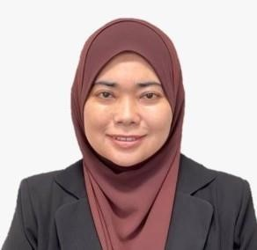
PERNAS’ Board of Directors
CHAIRPERSON
YBHG. DATO’ HAZIMAH BINTI ZAINUDDIN
GOVERNMENT REPRESENTATIVES
INDUSTRY PROFESSIONALS
MOF
KUSKOP
KPDNHEP
YBRS. PUAN AFIDAH AZWA BINTI ABDUL AZIZ
YBHG. DATO’ SURIANI
BINTI DATO’ AHMAD
YBHG. DATUK ROZIAH
BINTI ABUDIN
YBHG. DATO’ ABU BAKAR
AS-SIDEK BIN
DATO’ HJ. MOHD. SIDEK

Slide 8
PERNAS’ FOCUS

Slide 9
PERNAS’ Focus
Income
Groups
SME
Groups
Funding
and Risk
PERNAS’
Effort
Resources
and Returns
Fund Size
Products
T20
Large
Corporate Investment
Equity investment from RM2 mil and up to RM50 mil
Up to RM50 mil
10 %
PERNAS’ Focus
Commercial and
Profitability
SME Financing
Franchisor and Pre-franchisor:
Value: RM50k – RM2 mil
Margin: Up to 70% | Rate: 6% - 8%
Tenure: Up to 10 years
Franchisee:
Value: RM50k – RM2 mil
Margin: Up to 70% | Rate: 4.75% – 5%
Tenure: Up to 7 years
M40
Medium
RM500k - RM2 mil
50 %
MORE RESOURCES REQUIRED
MORE FUNDING REQUIRED
LOWER RETURNS
LESS RISK
Franchise
financing
B40
Small and Micro
Micro Financing: Business in Transformation (BIT)
Pre-franchisor:
Value: Up to RM500k
Margin: Up to 90% | Rate: 4.75%
Tenure: Up to 5 years
Pre-franchisee:
Value: Up to RM25k
Margin: Up to 90% | Rate: 4.75%
Tenure: Up to 3 years
Sustainable
Development
Up to RM500k
40 %

Slide 10
PERNAS’ HEADQUARTERS AND CORRIDOR OFFICES

Slide 11
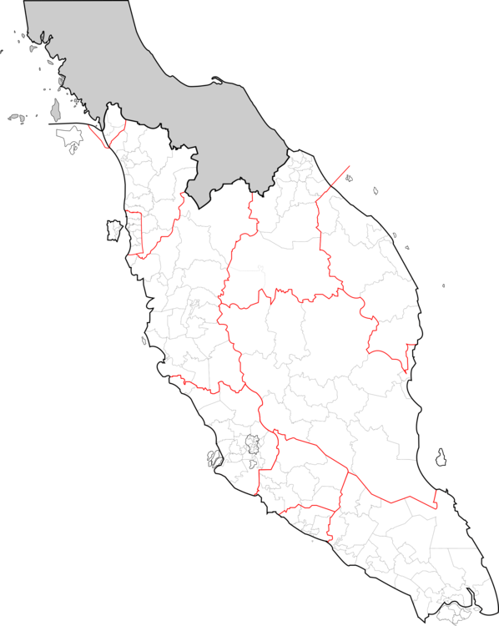
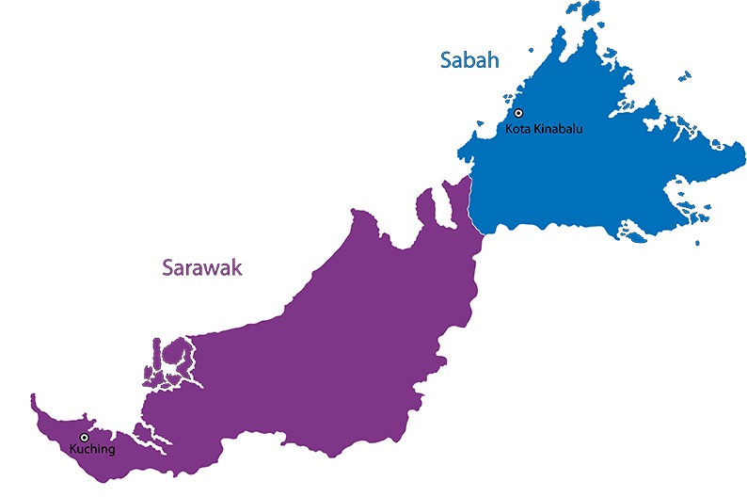
PERNAS’ Headquarters And Corridor Offices Are Spread Across The Country
GREATER

Slide 12
PERNAS’ PRODUCTS AND SERVICES

Slide 13
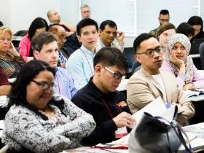
PRODUCTS AND SERVICES OFFERED BY PERNAS
To become the leading organization
for franchise development and a center of excellence in entrepreneurship
DEVELOPMENT
FINANCING
INVESTMENT
Franchise Development
Franchise Institute
Financing
Property
Equity
Subsidiary
Treasury
13

Slide 14
PRODUCTS AND SERVICES OFFERED BY PERNAS
1
FINANCING
2
EQUITY
3
PROPERTY
Financing Size: RM50,000 – RM2 million
Principle: Islamic (Tawarruq Concept)
Tenure: Up to 10 years
Rate: 5.00% - 8.00%
Investment Size: Minimum RM2 million
Tenure: Up to 5 years
Equity Shareholder: Up to 49%
Investment Instruments:
Common Shares and Preference Shares iRCPS
Target IRR: 6% to 8%
Aim for healthy growth with potential for further expansion
Provision of commercial space in strategic locations for entrepreneurs at competitive rental rates
Tenure: Up to 10 years
Franchisor Financing Scheme
Franchisee Financing Scheme
Pre-Franchise and Master Franchise Financing Scheme
Licensor and Licensee Financing Scheme
Mezzanine Financing Scheme
Pre – IPO Scheme
Franchise Equity
Commercial Space Rental Scheme
14

Slide 15
PRODUCTS AND SERVICES OFFERED BY PERNAS
4
SUBSIDIARIES
5
FRANCHISE INSTITUTE
6
TREASURY
Wonderful Lifestyle Sdn. Bhd.
Big Nineteen Sdn. Bhd.
Objectives of Franchise Institute (FI)
Provide comprehensive training focused on franchising and entrepreneurship.
Provide awareness briefings on entrepreneurial franchising to the public.
Investment in Money Market
Investment Portfolio
PNS ASQ Asia Sdn. Bhd.

Slide 16
FRANCHISE BRANDS

Slide 17
We work with over 100 franchisors to expand their business by financing them and their franchisees
Food & Beverage
PERNAS’ House Brands
Education
Services

Slide 18
PERNAS’ SUBSIDIARIES

Slide 19
Corporate Structure: PERNAS Has Five (5) Subsidiaries
100%
Malaysia International Franchise Sdn. Bhd
100%
100%
100%
51%
Wonderful Lifestyle Sdn. Bhd
Big Nineteen Sdn. Bhd
Visi Anugerah Sdn. Bhd
Pernas ASQ Asia Sdn. Bhd

Slide 20
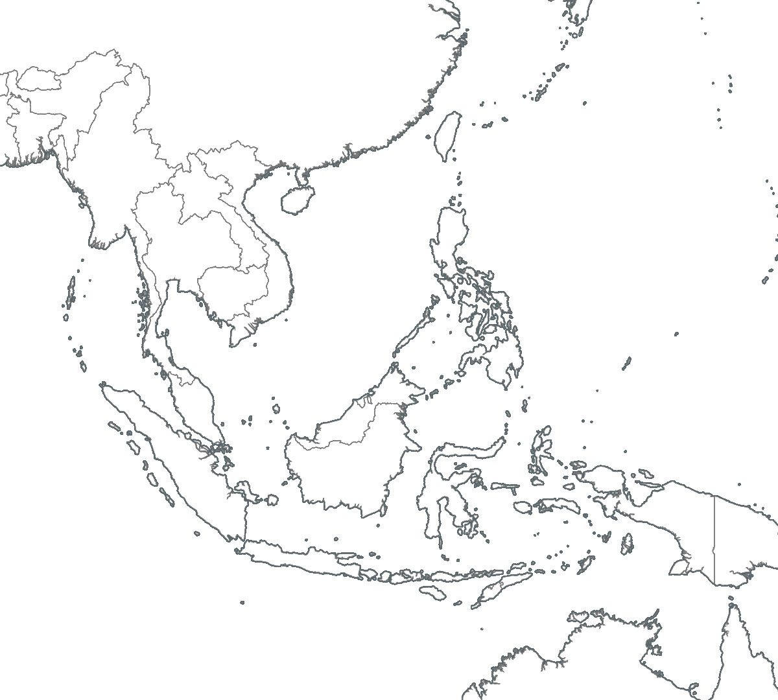
Gloria Jean’s Coffees
TOTAL OUTLETS
8
MYANMAR
49
49
1
Outlets in Malaysia
BRUNEI
MALAYSIA
9
Outlets in Other Countries
58
Total

Slide 21
1901
TOTAL OUTLETS
43
43
Outlets in Malaysia
MALAYSIA
0
Outlets in Other Countries
43
Total

Slide 22
Abdul Samad Qurashi
TOTAL OUTLETS
1
1
Outlets in Malaysia
MALAYSIA
0
Outlets in Other Countries
1
Total

